Slide 1
CHIME: An Efficient
Error-Tolerant Chinese
Pinyin Input Method
Yabin Zheng¹, Chen Li², and Maosong Sun¹
¹Tsinghua University
²University of California, Irvine

Slide 2
Outline
Introduction
Related Work
Correcting a Single Pinyin
  Finding Similar Pinyins
  Ranking Similar Pinyins
Converting Pinyin Sequences to Chinese Words
  Pinyin-to-Chinese Conversion without Typos
  Pinyin-to-Chinese Conversion with typos
Experiments
Conclusions

Slide 3




Introduction
What is Chinese Pinyin input method
  Users cannot type in Chinese characters directly
  Pinyin input methods are proposed
    Users mentally generate a Chinese word “上海”
    Type in corresponding Pinyin “shanghai”
    Input methods display words with this pronunciation

Slide 4



Introduction (cont.)
A beginner of Chinese language
  篮球 (basketball), lanqiu or lanchiu
Users in southern China
  开花(bloom), kaihua or kaifa

Slide 5






Introduction (cont.)
  Users may make typos when typing Pinyins
Users have to identify and correct typos
We need error-tolerant Pinyin input method

Slide 6







Introduction (cont.)
Two challenges in developing “CHIME” (CHinese Input Method with Errors)
  Accuracy
  Efficiency

Slide 7
Correcting a Single Pinyin
Pinyin dictionary D, an input Pinyin p that is not in D
Find a set of similar candidate Pinyins
  Similarity measure: edit distance
  Empirically keep top-3 candidate Pinyins
Pinyin Dictionary D
……
shanghai
canghai
wanghuai
……
p = sanghaai
w

Slide 8
  Finding Similar Pinyins
Efficient similarity search
  State-of-the-art Index structure and search algorithm (Ji et al., 2009)
  woemng gounai le sanghaai shengchang de niulai
Input Pinyin | Similar Candidate Pinyins
woemng | women, weng, wodang
gounai | goumai, dounai, guonei
le | le
sanghaai | shanghai, canghai, wanghuai
shengchang | shengchan, zhengchang, shangchang
de | de
niulai | niunai, niupai, niuli

Slide 9
  Ranking Similar Pinyins
  Given a mistyped Pinyin p, rank candidate p’ using Pr(p’|p)
  Noisy channel error model
  Estimate conditional probability
  Pr(sanghaai|shanghai) = Pr(‘h’->‘~’)Pr(‘~’->‘a’)
Pinyin Dictionary D
……
shanghai
canghai
wanghuai
……
Noisy channel model
p’ = shanghai
p = sanghaai

Slide 10
  Pinyin-to-Chinese Conversion without Typos
Convert a Pinyin sequence P = p₁ p₂ … p_{k} to the most probable sequence of Chinese word W = w₁ w₂ … w_{k}
Pr(W) is estimated using a bigram language model

Slide 11
  Pinyin-to-Chinese Conversion with Typos
P = p₁ p₂ … p_{k} (P have typos), P’ denotes the correct Pinyin sequence
Given P’, Pinyin sequence P and word sequence W are conditionally independent

Slide 12
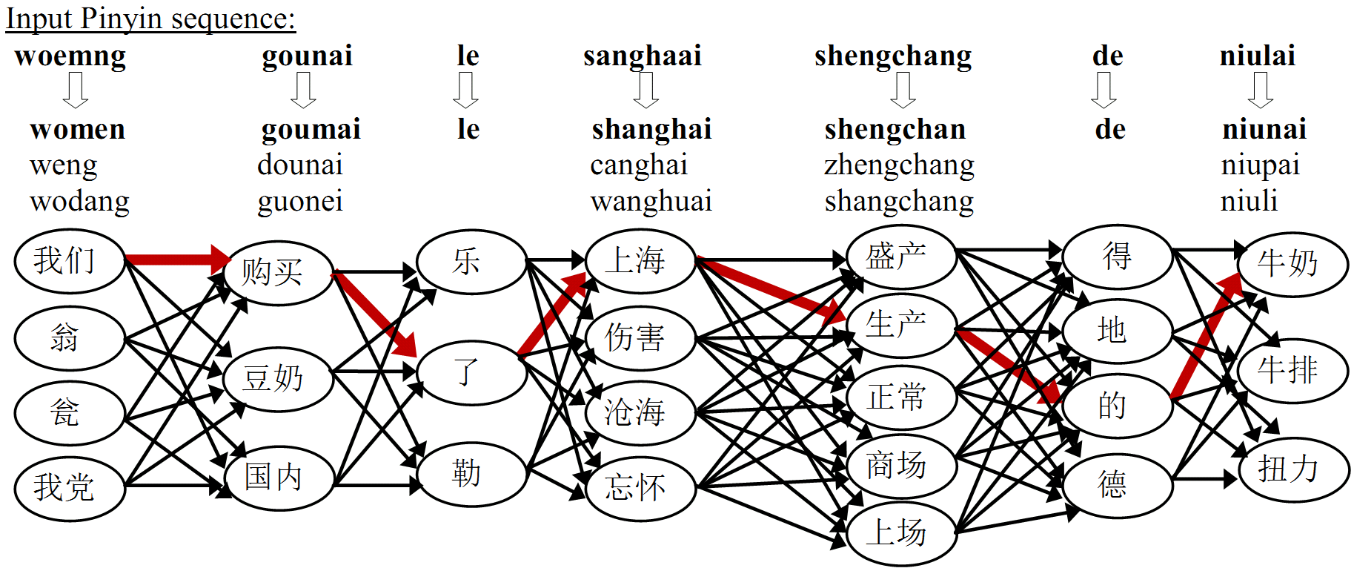
Framework of CHIME
Correct mistyped Pinyins in the Pinyin sequence
Convert corrected Pinyin sequence to Chinese words

Slide 13

Experimental Settings
Sun-Pinyin software
  Pinyin dictionary and language model
  104,833 Chinese words and 66,797 Pinyins
Lancaster corpus (McEnery and Xiao, 2004)
  Five native-speakers type in 2,000 sentences for evaluation
  679 sentences (34%) contain one or more typos
  885 typos are collected in total
Computer with AMD Core2 2.20GHz CPU and 4GB memory, C++ compiled with a GNU compiler

Slide 14
Probabilities of Edit Operations
Pr(e) is not uniformly distributed
Pr(‘z’->‘s’) > Pr(‘z’->‘p’)
  ‘z’ and ‘s’ are adjacent on the keyboard
  ‘z’ and ‘s’ pronounce similarly
Heuristic rules based on Chinese-specific features
Feature | Example pairs of similar Pinyin letters
Front and back nasal sound | ‘ang’ - ‘an’, ‘ing’ - ‘in’, ‘eng’ - ‘en’
Retroflex and blade-alveolar | ‘zh’ - ‘z’, ‘sh’ - ‘s’, ‘ch’ - ‘c’
Letters with similar pronunciations | ‘z’ (兹) - ‘c’ (词) - ‘s’ (丝), ‘n’ (呢) - ‘l’ (勒), ‘b’ (播) – ‘p’ (泼)

Slide 15
Evaluation Metrics
E₁: A mistyped Pinyin is not detected, Detection error rate DER = E₁ / T
E₂: A mistyped Pinyin is not suggested to the correct Pinyin, Correction error rate CorrER = E₂ / T
E₃: A mistyped Pinyin is not converted to the correct Chinese word, Conversion error rate ConvER = E₃/T
Commercial software Sogou-Pinyin for comparison
Metric | DER | CorrER | ConvER
CHIME | 37.40% | 52.43% | 53.56%
Sogou | 70.62% | 91.19% | 91.75%

Slide 16
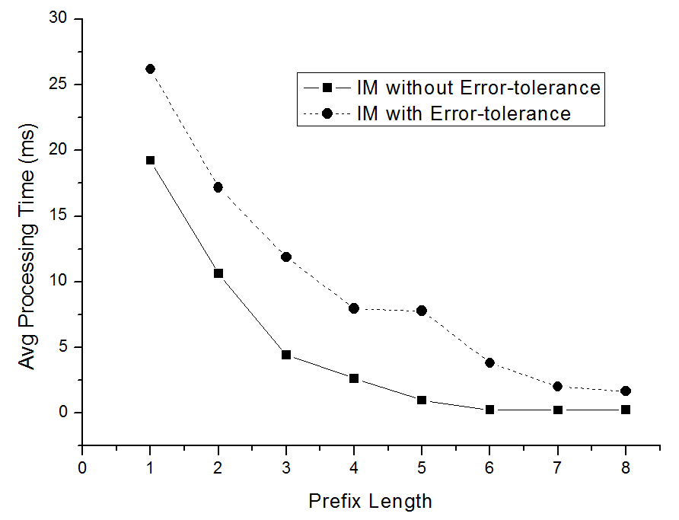
Efficiency Evaluation
Average processing time: 12.9ms/sentence
Processing time decreases with more letters typed in
Additional processing time of 4.97ms for CHIME

Slide 17
Saved Typing Efforts
CHIME can return Chinese words before users type in a complete Pinyin sequence
Original Pinyin Sequence | Actual Pinyin Sequence | Converted Chinese Words | Saved Typing Efforts
woemng gounai le sanghaai shengchang de niulai | woem gouna l sangh shengc d niulai | 我们 购买 了 上海 生产 的 牛奶 | 26.1%
zaichang oizhe fenfen juqi shexiangji | zaicha oiz fenfe juqi shexiangj | 在场 记者 纷纷 举起 摄像机 | 16.2%
zhuajin richang shenghou de uifu gongzuo | zhuaji rich shengh d uifu gongz | 抓紧 日常 生活 的 恢复 工作 | 22.5%
yixie caidtan changjina gfennu le | yix caidt changj gfennu l | 一些 彩电 厂家 愤怒 了 | 24.2%
quanguo xiyhiji shohoufuwu youxiu changjia | quang xiyhiji shohouf youxiu changj | 全国 洗衣机 售后服务 优秀 厂家 | 16.7%
shenchanguosheng de duo suhyu laodongmimixing chanpin | shenchanguos d duo suhy laodongmimi chanp | 生产过剩 的 多属于 劳动密集型 产品 | 22.6%
shangpingjingji qianglie fuhuan kexuejishu de zhichi | shangpingji qiangl fuhuan kexuejish d zhic | 商品经济 强烈 呼唤 科学技术 的 支持 | 19.2%
tigao canping zhiliang yu guanni suiping | tiga canp zhilia yu guanni suipi | 提高 产品 质量 与 管理 水平 | 20.0%
jinnialai sulian gounei de gezhong maodun zhujian tuchu | jinniala sulian goune d gezh maod zhujian tuc | 近年来 苏联 国内 的 各种 矛盾 逐渐 突出 | 18.2%
changchtunshi chengshi guihua guanli tiaoil | changchtunsh chengs guih guanl tiaoil | 长春市 城市 规划 管理 条理 | 14.0%

Slide 18
Related Work
Pinyin-to-Chinese conversion
  Statistical segmentation and language model based approach [Chen and Lee, 2000]
    They only correct single-character errors
  Extract Chinese Pinyin names from English text and suggest corresponding Chinese characters [Kwok and Deng, 2002]
    They only convert Pinyin names to Chinese characters
  Commercial Pinyin input methods use rule-based approaches to handle typos

Slide 19
Related Work (cont.)
English spelling corrections
  Noisy channel models based on generic string-to-string edit operations (Brill and Moore, 2000)
  Pronunciation information is useful for English spelling correction (Toutanova and Moore, 2002)
  Query log and click-through data in English spelling correction (Cucerzan and Brill, 2004; Sun et al., 2010; Whitelaw et al., 2009)
  These methods are not directly applicable to the Chinese language

Slide 20
Conclusion and Future Work
Conclusion
  Error-tolerant features are important for Chinese Pinyin input method
  CHIME finds similar Pinyins for a mistyped Pinyin and ranks candidate Pinyins using language-specific features
  CHIME detects and corrects Pinyin sequence, and finds most likely sequence of Chinese words
  CHIME achieves both a high accuracy and efficiency
Future Work
  Correct a mistyped Pinyin that included in the Pinyin dictionary
  Support acronym Pinyin input (e.g. “zg” for “中国”)

Slide 21
Reference
[Brill and Moore, 2000] E. Brill and R.C. Moore. An improved error model for noisy channel spelling correction. In Proceedings of the 38th Annual Meeting on Association for Computational Linguistics, pages 286–293. Association for Computational Linguistics, 2000.
[Chen and Lee, 2000] Z. Chen and K.F. Lee. A new statistical approach to Chinese Pinyin input. In Proceedings of the 38th Annual Meeting on Association for Computational Linguistics, pages 241–247. Association for Computational Linguistics, 2000.
[Cooper, 1983] W.E. Cooper. Cognitive aspects of skilled typewriting. Springer-Verlag, 1983.
[Cucerzan and Brill, 2004] Silviu Cucerzan and Eric Brill. Spelling correction as an iterative process that exploits the collective knowledge of web users. In Proceedings of the 2004 Conference on Empirical Methods in Natural Language Processing, pages 293–300. Association for Computational Linguistics, 2004.
[Damerau, 1964] F.J. Damerau. A technique for computer detection and correction of spelling errors. Communications of the ACM, 7(3):171–176, 1964.
[Gao et al., 2002] J. Gao, J. Goodman, M. Li, and K.F. Lee. Toward a uniﬁed approach to statistical language modeling for Chinese. ACM Transactions on Asian Language Information Processing (TALIP), 1(1):3–33, 2002.
[Gao et al., 2010] Jianfeng Gao, Xiaolong Li, Daniel Micol, Chris Quirk, and Xu Sun. A large scale ranker-based system for search query spelling correction. In Proceedings of the 23rd International Conference on Computational Linguistics, pages 358–366, 2010.
[Ji et al., 2009] S. Ji, G. Li, C. Li, and J. Feng. Efficient interactive fuzzy keyword search. In Proceedings of the 18th international conference on World wide web, pages 371–380. ACM, 2009.

Slide 22
Reference(cont.)
[Jurafsky et al., 2000] D. Jurafsky, J.H. Martin, and A. Kehler. Speech and language processing: An introduction to natural language processing, computational linguistics, and speech recognition. MIT Press, 2000.
[Kernighan et al., 1990] M.D. Kernighan, K.W. Church, and W.A. Gale. A spelling correction program based on a noisy channel model. In Proceedings of the 13th conference on Computational linguistics, pages 205–210. Association for Computational Linguistics, 1990.
[Kwok and Deng, 2002] Kui-Lam Kwok and Peter Deng. Corpus-based pinyin name resolution. In Proceedings of the First SIGHAN Workshop on Chinese Language Processing (COLING), pages 41–47, 2002.
[McEnery and Xiao, 2004] AM McEnery and Z. Xiao. The Lancaster Corpus of Mandarin Chinese: A corpus for monolingual and contrastive language study. Religion, 17:3–4, 2004.
[Ristad et al., 1998] E.S. Ristad, P.N. Yianilos,M.T. Inc, and NJ Princeton. Learning string-edit distance. IEEE Transactions on Pattern Analysis and Machine Intelligence, 20(5):522–532, 1998.
[Sun et al., 2010] Xu Sun, Jianfeng Gao, Daniel Micol, and Chris Quirk. Learning phrase-based spelling error models from clickthrough data. In Proceedings of the 48th Annual Meeting of the Association for Computational Linguistics, pages 266–274. Association for Computational Linguistics, 2010.
[Toutanova and Moore, 2002] K. Toutanova and R.C. Moore. Pronunciation modeling for improved spelling correction. In Proceedings of the 40th Annual Meeting on Association for Computational Linguistics, pages 144–151. Association for Computational Linguistics, 2002.
[Whitelaw et al., 2009] C. Whitelaw, B. Hutchinson, G.Y. Chung, and G. Ellis. Using the web for language independent spellchecking and autocorrection. In Proceedings of the 2009 Conference on Empirical Methods in Natural Language Processing, pages 890–899. Association for Computational Linguistics, 2009.

Slide 23
Thanks & QA

Slide 24
CHIME: An Efficient
Error-Tolerant Chinese
Pinyin Input Method
Yabin Zheng¹, Chen Li², and Maosong Sun¹
¹Tsinghua University
²University of California, Irvine

